Slide 1
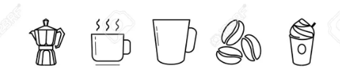
Café Loyalty Program
Distributed Systems Group 9
Anastasiia Khomenko | Charbel Nebo | Karan Dua | Shauna Gurhy
22304231 | 18324228 | 21331391 | 18324848
khomenka@tcd.ie | neboc@tcd.ie | duak@tcd.ie | gurhys@tcd.ie

Slide 2
Functional Requirements
The functional requirements of the Cafe Loyalty Program application are:
API Gateway - Required to provide a single entry point for clients to access multiple microservices.
Service Registry - Required for communication between various microservices..
Create Customer - Required to create a new customer entity based on the information provided.
Fetch Details - Required to retrieve customer details based on the information provided and to update the cache with updated customer details.
Login - Required to validate customer login credentials (username and password).
Update Transaction - Required to update transactions of customers.
Get Transaction History - The transaction history should accurately reflect the previous transactions.
Generate Voucher - Required to generate vouchers when enough points have been accrued by the customer.
Get Voucher - Required to output a list of vouchers reflective of those generated by the user.
Redeem Voucher - Required to allow customers to redeem vouchers against their purchases.

Slide 3
Non-Functional Requirements
Performance
Spring cache was implemented for fetch customer service (to reduce the consumption of resources and time in processing data of existing customers)
Can add customer details to cache when a customer has more than 10 transactions in a month (store details of frequently visiting customers in the cache for faster retrieval of customer details and overall performance improvement).
Reliability
Replication strategy for our database (provide better reliability for our system as in the event of a database failure).
Scalability
Microservice-based architecture, allows us to scale up and scale down certain services without impacting the system.
Availability
Deployed our application on Kubernetes to ensure high availability of all microservices. It ensures equal distribution of load on all pods for a microservice, thereby ensuring that the workload is evenly distributed and the application remains responsive.

Slide 4
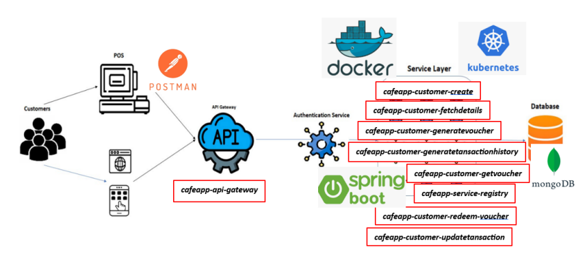
Architecture Diagram

Slide 5

MongoDB
We have used MongoDB as database for our application
MongoDB is horizontally scalable which makes it perfect choice for our application as it require high availability and scalability
We have implemented Master-Slave replication strategy for our database. This will provide better reliability for our system as in the event of a database failure we can involve promoting a slave database instance to become the new master, or restoring from a backup.

Slide 6
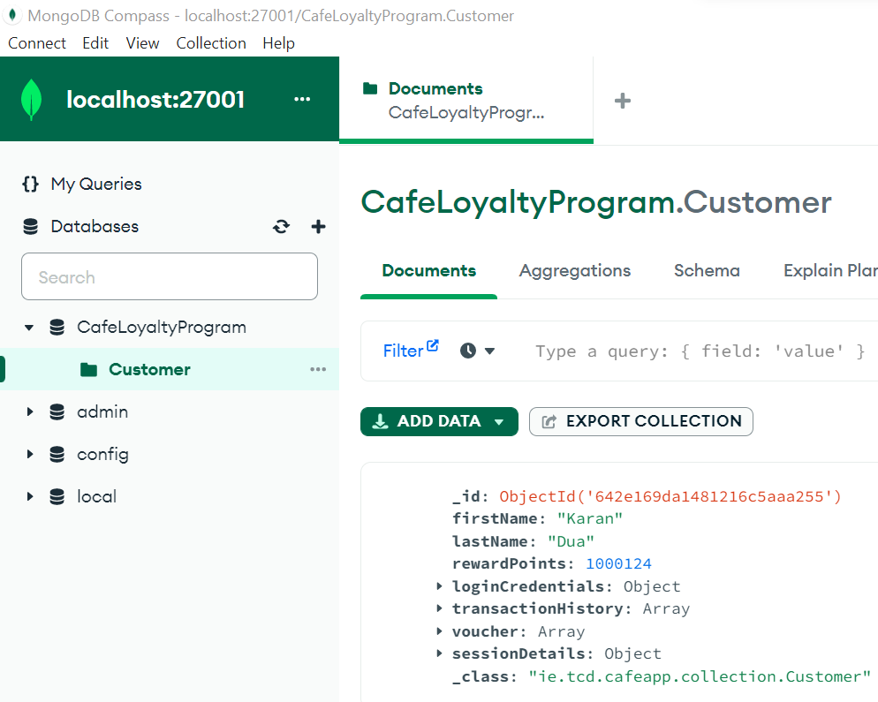
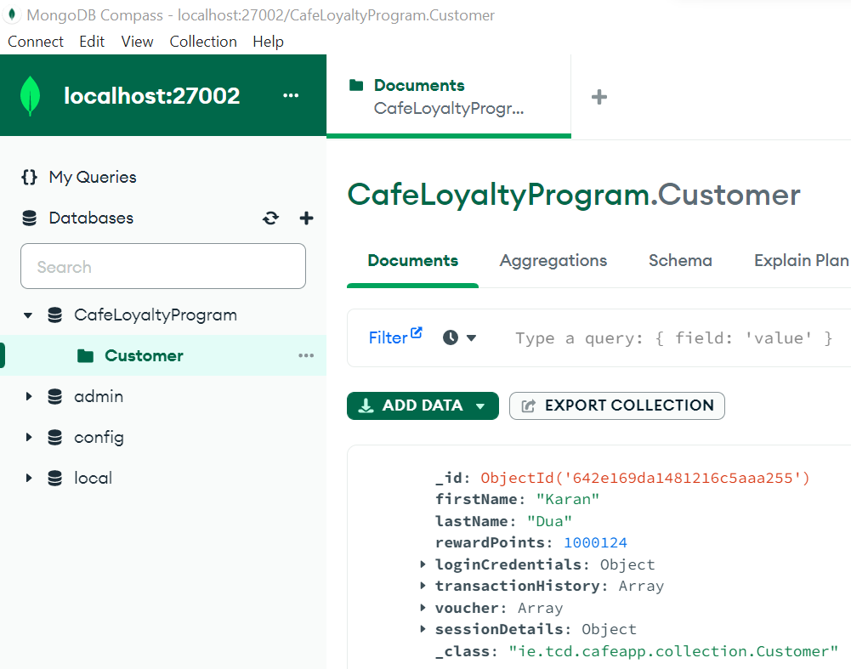
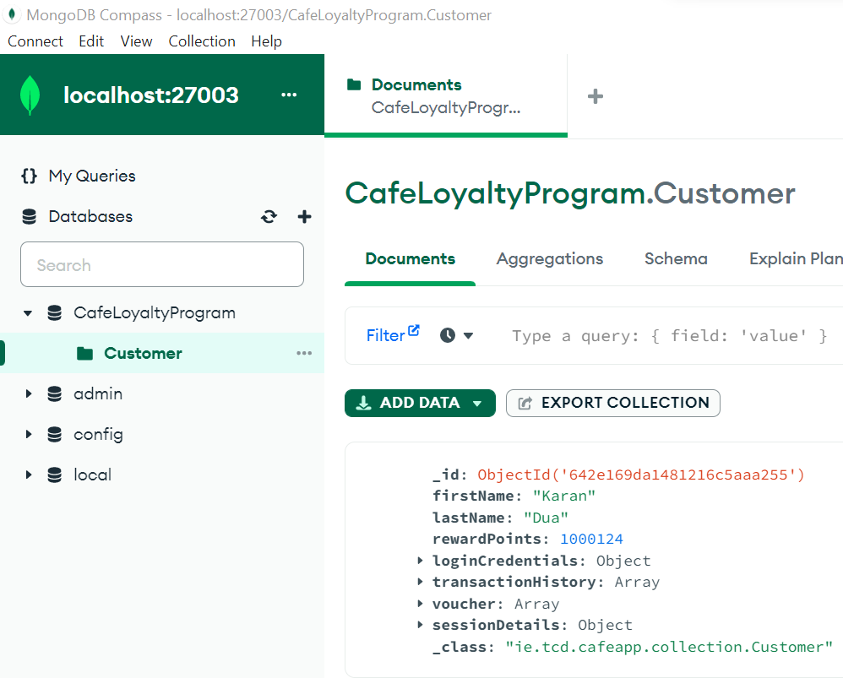
MongoDB
Primary
Secondary_1
Secondary_2

Slide 7

Zipkin
We are using Zipkin and Sleuth to implement distributed logs service for our microservices
Zipkin provides a unified dashboard to monitor logs for all requests.
Furthermore, it also embeds a unique trace-id in each log. This trace-id can be used to search any log or implement checkpointing in the application.

Slide 8
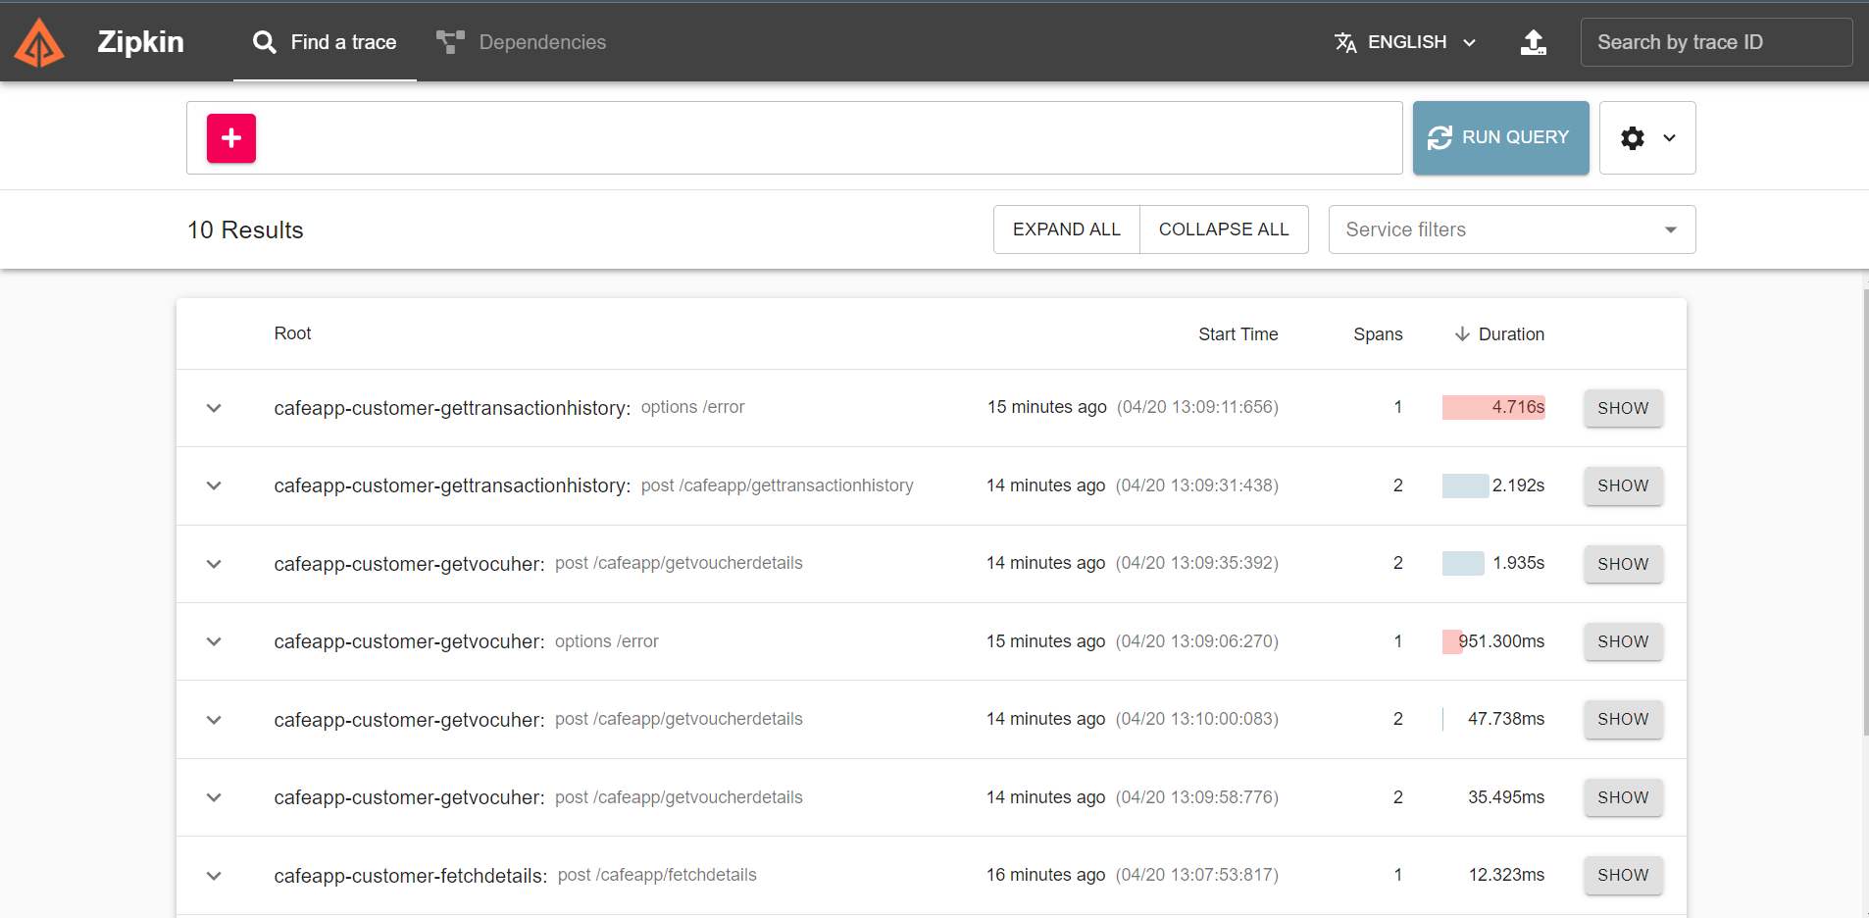
Zipkin
Notes:
Here you can see each of the trace logs used in our app and you can also search for a particular trace using a trace id

Slide 9
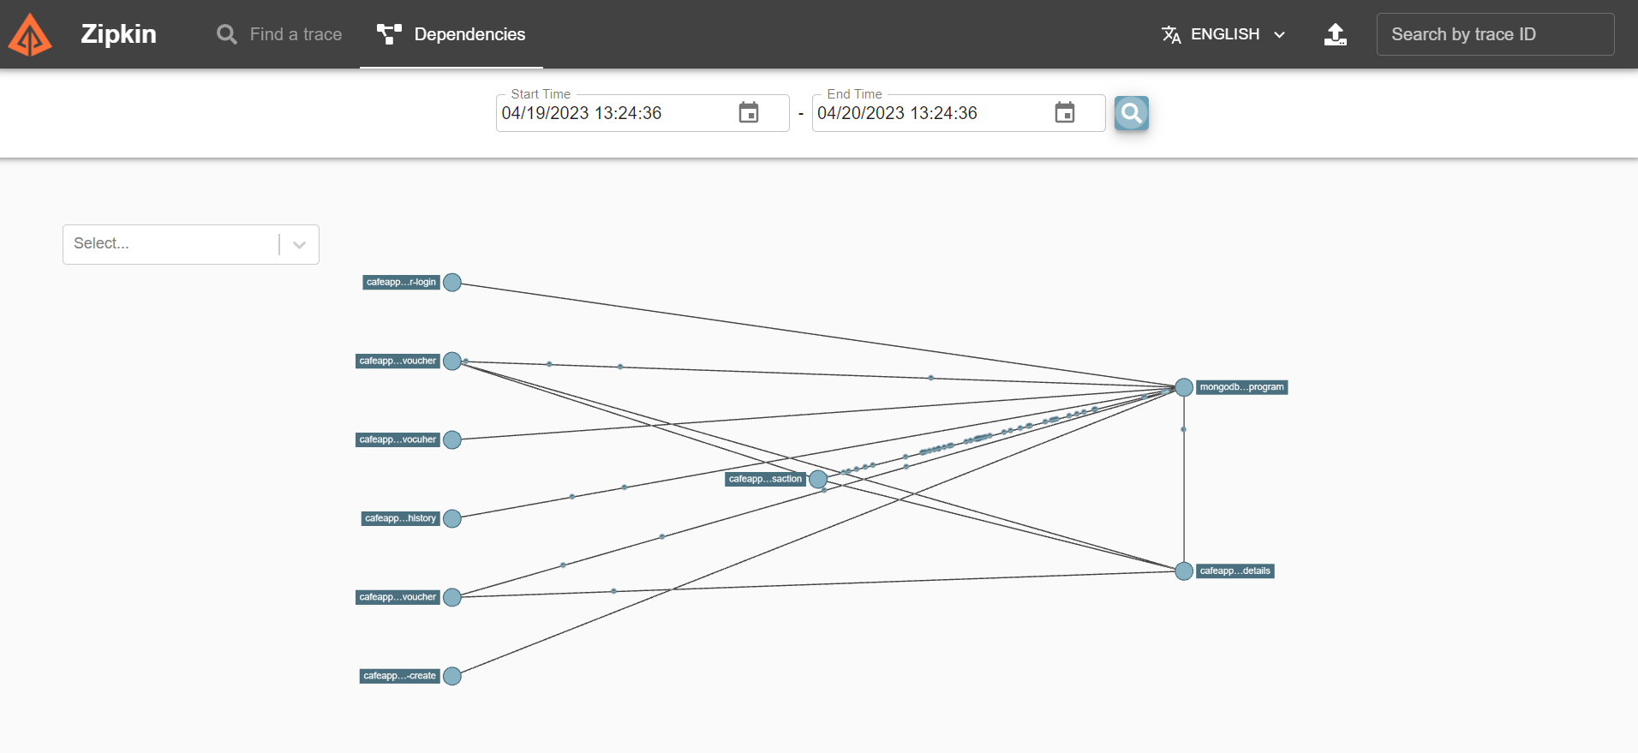
Zipkin

Slide 10
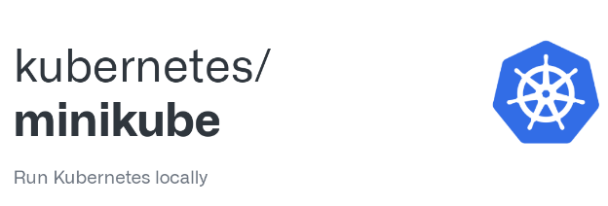
Minikube, Kube Forwarder
We are using Minikube as an orchestrator to deploy our microservices
Currently, we have deployed only 2 microservices on Minikube due to resource constraint on our laptop.
This is done to highlight that this functionality is supported by our application.
We have also used to access Kubernetes cluster’s internal resources.
This was done to bind an external port to the microservices deployed on Minikube.

Slide 11



Spring Boot Microservices
Create Customer - New Customer created with username and password, requires unique username. 1000 reward points given to new customer.
Login Customer - Login using username and password, checks username exists with matching password and creates a session ID needed to access other services.
Fetch Customer Details - Retrieves customer details based on the session ID and updates the cache based on number of transactions.
Update Transaction - Customer gets 1 reward point for every euro spent, if the number of transactions is more than 10 in last month, adds customer details to cache.
Generate Voucher - €5 voucher for the customer for every 500 loyalty points that the customer has in his rewards balance. Need at least 100 reward points to generate a voucher, and voucher amount depends on reward points.
Get Voucher Details - Retrieves voucher details for a given user. Vouchers have a validity period of 1 month from the date of generation.Expired vouchers are removed from voucher list.
Redeem Voucher - Checks validity and billing amount, if both acceptable applies to purchase and new voucher balance returned to customer.
Service Registry - allows other microservices to register themselves and discover other services registered with the Eureka server. All the microservices self-register themselves to service registry during boot up.
API Gateway - provides a single-entry point for clients to access multiple microservices. It routes incoming requests to our other microservices responsible for different functionalities of the app.

Slide 12

Eureka Dashboard
We are using Eureka server as a service registry for our Application.
When a microservice spins up, it registers itself on service registry.
Eureka dashboard can also be used to monitor if all services have registered before application goes online.

Slide 13
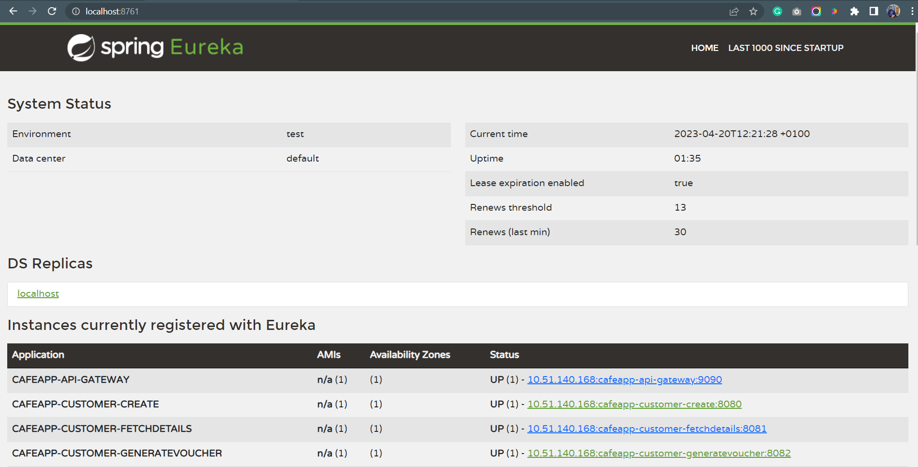
Eureka Dashboard

Slide 14

Netflix Hystrix
We are using Netflix hystrix to implement failover mechanism for our microservices.
We have created a failover handler for all the microservices in our application.
Currently, the failover method only return an error message, but it can be easily configured to re-route the request to failover handling microservice

Slide 15
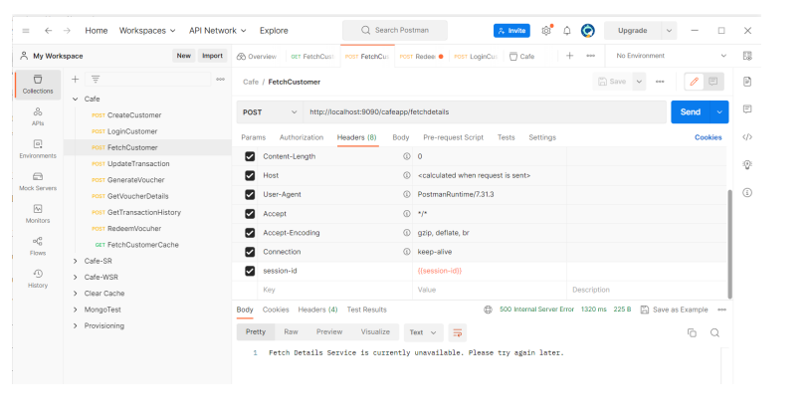
Netflix Hystrix

Slide 16
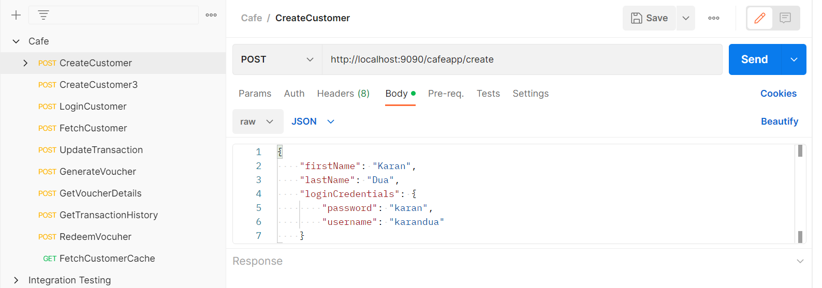

Postman
We have used Postman to test all our services

Slide 17
Testing
We have validated user-session for each request in the application.
Appropriate error message is returned if the session is not valid.
We have also performed failover testing to see if the failover mechanism is working properly as per expectations.
We have also tested scaling up and scaling down Kubernetes pods to improve availability and performance.
We have also tested distributed logs and verifying trace ids in logs
We have also tested that data is fetched from cache for frequently visiting customers.

